Slide 1

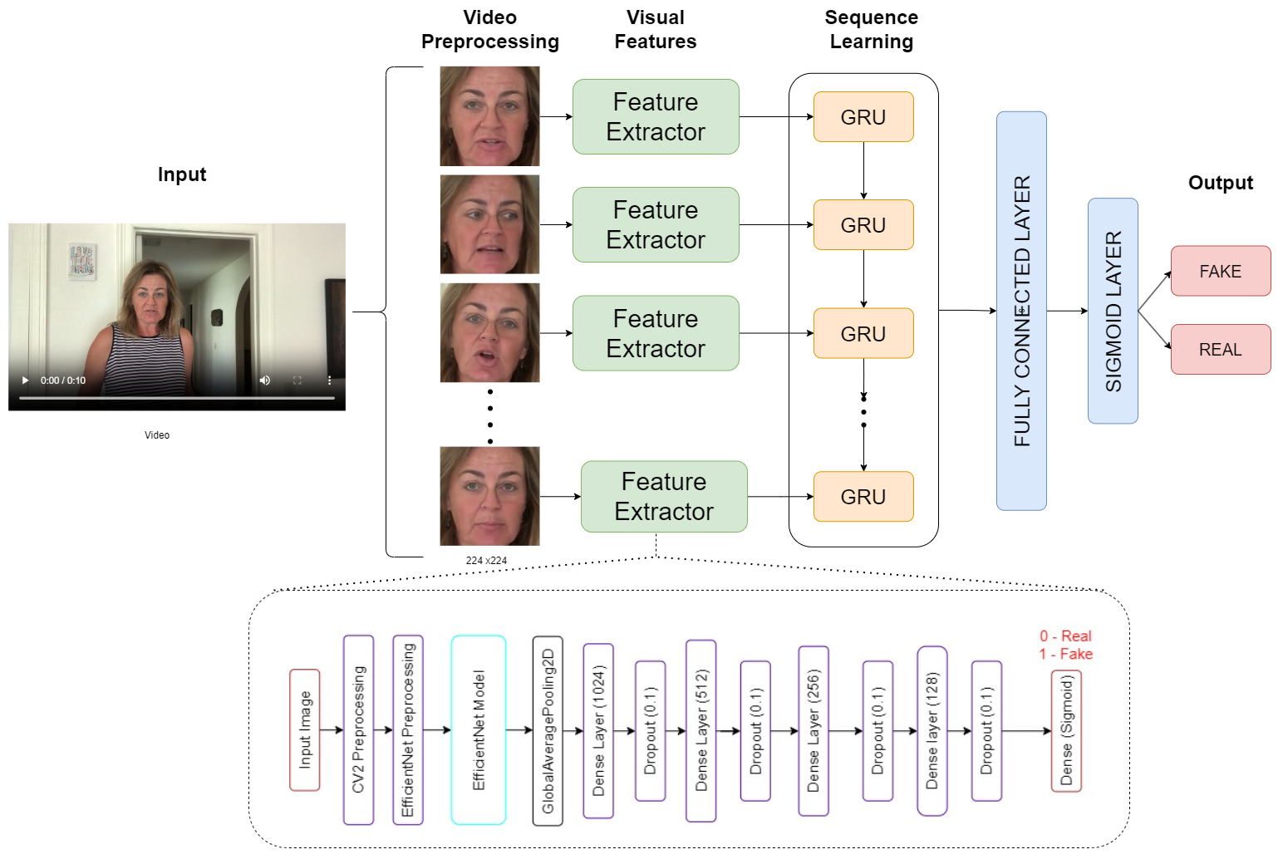
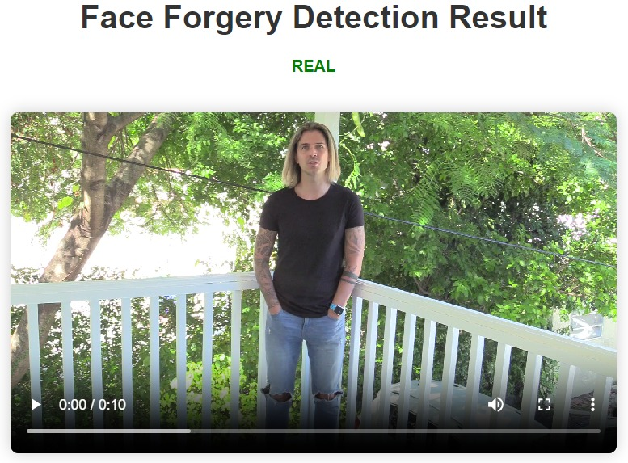
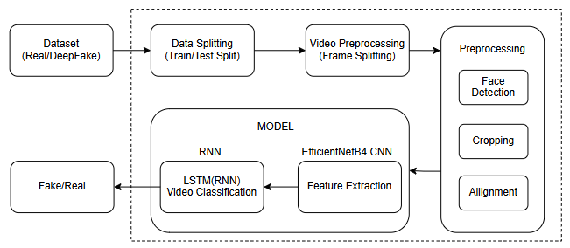
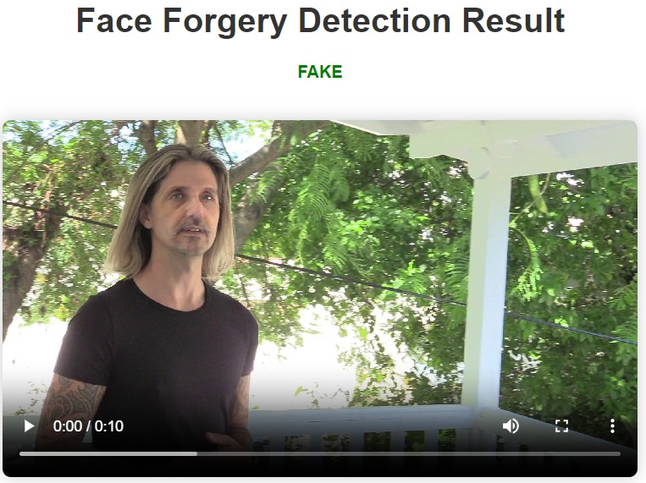
Project title: Detecting Face Forgery in Videos using Deep Learning
Team members names: Somil Yadav, Harsh Kashyap, Abhinav Anand, Sanjana Habib
Guide Name: Prof. Guruprasad Konnurmath
Minor Project -2
23ECSW304
TM
Domain: HPC
Problem statement: To Develop a robust deep learning model combining EfficientNetB4 (CNN) and GRU (RNN) to detect face forgeries in videos. The model aims to accurately identify forged media by leveraging spatial features and temporal inconsistencies.
Architecture
Proposed work
Training Feature Extractor: Train an EfficientNetB4 model with data augmentation and additional dense layers to extract robust features from video frames.
Load and Preprocess Video Frames: Extract and crop faces from video frames using Haar Cascade, then resize and preprocess the faces.
Feature Extraction: Use the trained EfficientNetB4 model to extract deep features from each frame of the video.
Prepare Data for Sequential Model: Create frame masks and organize extracted features into consistent-length sequences for each video.
Train Sequential Model: Construct and train a GRU-based model on the sequential frame features to learn temporal dependencies and classify videos.
Predict and Visualize: Implementing a function to load video, extract features, predict forgery using the trained models, and visualize frames with predictions. Visualize frames with predictions to indicate real or fake status.
Objectives
To develop a CNN model using EfficientNetB4 for feature extraction, optimizing it to capture detailed video frame information.
Integrating the CNN model with a GRU architecture to process temporal dependencies and enhance face forgery detection in videos.
Training the combined model on a diverse dataset to ensure robust performance in identifying face forgery.
Methodology
Dataset: Deepfake Detection Challenge(DFDC) dataset from Kaggle.
Preprocessing: Frame extraction, resizing, and balancing the dataset.
Utilize OpenCV (cv2) and the Haar Cascade classifier to accurately detect faces in videos.
Results & Discussions
0.54
Conclusion
The face forgery detection model achieved excellent performance with the EfficientNetB4 feature extractor, demonstrating a test loss of 0.2476 and a test accuracy of 0.8961.
Integrating these features into a GRU-based sequential model further improved the detection capabilities.
This combined approach proves effective in identifying deepfakes, showcasing its potential for real-world applications in video authentication and digital forgery prevention.
a
Video classification on a real video
0.14
Image classification on faces
Video classification on a fake video

